Slide 1

Passenger Satisfaction on Airline Company
Done by: Sara Alqhtani
Submit to: Dr.Essam Al Daoud

Slide 2
Introduction

Slide 3
Customer Satisfaction
Satisfied
Neutral or Dissatisfied
Data consists of the details of customers in an airline company who have already flown with them.
Project Goal is to forecast whether a future customer will be satisfied with their service and which aspects of their services should be highlighted more to increase customer satisfaction.
Model Benefit to increase the quality of their services

Slide 4
Exploring data
129880 observation (train data 103904, test data 25976).
25 features :numeric and object type.
ID, Age, Fight Distance, infight wifi service, Department/Arrival time convenient, Ease of online booking, Gate location, Food and drink, online boarding, seat comfort, inflight entertainment, on-board service, baggage handling, check in service, inflight service, cleanliness, departure delay in minutes, arrival delay in minutes.
The youngest passenger is 7 years old, and the oldest passenger is 85 years old. Average age is 39.
Flight Distance column, we see that the minimum value is 414 and the maximum value is 4983. The average distance of flight is 1190.

Slide 5
Exploring data
Departure Delay in Minutes and Arrival Delay in Minutes columns, the minimum value is 0 (which corresponds to no delay in that flights), and the maximum value is around 1500.
The Categorical features evaluated in 0-1-2-3-4-5 degrees of satisfaction. Inflight service the highest level and Inflight wifi service the lowest.
target column consists of two categories which are "neutral or dissatisfied" and "satisfied".
we have 310 missing values in the Arrival Delay in Minutes row.
There are no duplicates values.

Slide 6
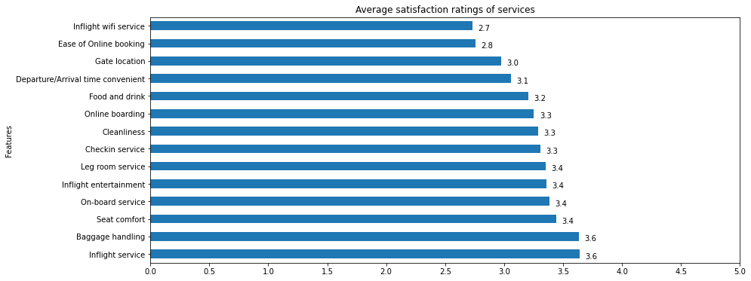
Exploring data

Slide 7
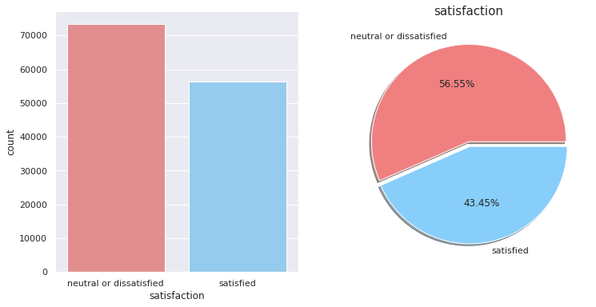
Exploring data

Slide 8
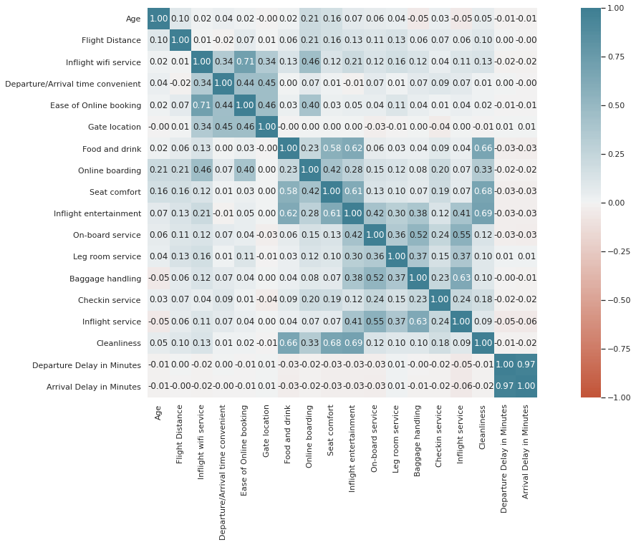
Correlation

Slide 9
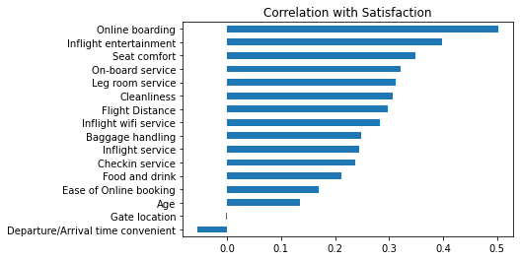
Correlation to the target
Online boarding:~ 50%
Gate location: ~ no correlation

Slide 10
Logistic regression model
Y= B1x1+…………..+Bixi
Y0: satisfied
Y1: neutral or dissatisfied

Slide 11
The model predicted most of the data correctly
 | Mean_CV | Std_CV | Train_Score | Test_Score | Precision_Score | Recall_Score | F1_Score
Logistic Regression | 0.872872 | 0.00206 | 0.872894 | 0.873755 | 0.868855 | 0.836679 | 0.852464

Slide 12
Findings and Recommendations
would be more meaningful if the data were divided into 3 groups as satisfied, neutral and dissatisfied passengers
services that affect satisfaction the most are Online boarding, Inflight wifi service, Inflight entertainment, Seat comfort, Cleanliness, and On board service.
Gender has no obvious effect on overall satisfaction
Passengers whose age is between 40 to 51 are more likely to be satisfied

Slide 13
Thank you for listening

